Slide 1
OOP152 – OBJECT-ORIENTED PROGRAMMING
2024

Slide 2
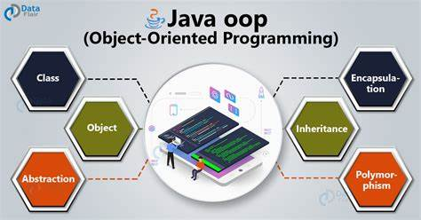
Object-oriented programming (oop152)
Welcome to the course Object Oriented Programming in JAVA. This course will cover a core set of computer science concepts needed to create a modern software application using Java.

Slide 3
Access: Books / Eclipse ide / MS office…etc.

Slide 4
Module Roadmap
11 weeks
Ends in October
A lot to cover in 3 Months

Slide 5
Formal SEMESTER/YEAR MARK SYM assessments
Formal SYM assessments– 100% of overall mark
Please note that ALL the assessments listed below will contribute to your final mark.
Type Online or Contact | Weighting | Compulsory | Duration (timed-based assessment) | Total marks
P_Participation | 10% | No | N/A | N/A
SS1_Formal Test | 25% | Yes | N/A | 50
SS2_ Assignment | 25% | Yes | N/A | 70
SS3_ Project | 40% | Yes | N/A | 100
TOTAL SYM | 50%

Slide 6
Summary SYM
PASS REQUIREMENTS
The Formal Assessments SS1, SS2, SS3 are COMPULSORY, and you need to complete all these assessments with a minimum of 50% as an overall final mark to pass the module.
For the formal SYM assessments (SS1, SS2, SS3), students will be offered a singular opportunity for resubmission pertaining to any assessments they did not pass.
Any resubmissions will be capped at 50%.

Slide 7
SEMESTER ASSESSMENT GUIDELINES – AN OVERVIEW
Type | Criteria to Qualify
P_Participation | Participation will be scored on class discussion, debates, class test, online assessment and/or class tutorials.
SS1_Formal Test | The test will be graded with a maximum score of 50 marks and will consist of a closed-book Theory section. To participate in this assessment, students must adhere to specific criteria.

Slide 8
SEMESTER ASSESSMENT GUIDELINES – AN OVERVIEW
Type | Criteria to Qualify
SS2_Assignment | Throughout the semester, students will undertake an assignment with a maximum score of 70 marks. To complete this assessment, students must meet specific criteria.
SS3_Project | This semester-long project, worth a maximum of 100 marks, will encompass various module-specific topics. Meeting specific criteria is essential for student participation in this assessment.

Slide 9

Rules of engagement (ROE)
Classroom rules provide the structure and guidelines needed to create a productive learning environment.
Arrive on Time: To keep the classroom running smoothly, arrive on time, switch on you PC and be ready to start class.
Turn Off Cell Phones and Electronic Devices: When class is in session, cell phones and other electronic devices (mp3 players, tablets) must be turned off.
Or Use Technology for Learning: If the class is using a form of technology such as computers or tablets for a lesson, use the technology for its intended purpose—learning. Don't browse the web or use social media
No Food or Drinks: Eating and drinking should be reserved for lunchtime. (Water bottles must be kept closed)
Attend to Personal Needs Before Class: Use the restroom or stop at your locker before class to avoid causing disruption for your fellow students
Bring Required Materials Every Day: Unless you have been instructed otherwise, come to class prepared with all of the required materials you were advised to bring at the beginning of the school year. Do not interrupt the teacher or other students to ask to borrow items you forgot to bring to class.
Use Polite Speech and Body Language: Always behave in a way that is respectful to your teacher and fellow students. Unkind teasing and impolite behavior are unacceptable at all times and may lead to disciplinary actions. Be respectful of other students when they are speaking. Any form of bullying will not be tolerated.
Speak When Permitted: Most of the time, you must raise your hand in class and wait to be called on before speaking. There may be times during group work when quiet talking is permitted. Be aware of when talking is and isn't allowed. It is important that students remain quiet during exams until all students have finished.
No Cheating: Students caught cheating will receive a zero and a phone call home. Both the student who shares his work and the person who copies it will suffer the same consequences. Be mindful of accidental cheating by covering your paper during exams and preparation of other graded assignments.
Listen and Follow Directions: It is important for you to pay attention in class and follow the teacher's directions. You will be a more successful student if you listen in class and follow instructions.
Never Pack up Before It's Time to Leave: It may be tempting to pack up early when it's getting close to the end of class. Nevertheless, you should wait until the teacher has dismissed you before preparing to leave.
Turn in Work on Time: Unless you have been given an extension, always turn in your work on time. Late assignments will receive a lower score.
Make up Missed Work: If you have missed a lesson or an assignment, make arrangements with your teacher to complete the work.
If You Have a Question, Ask for Help: If something is confusing—such as assignment instructions or something in your reading materials—ask your teacher or another student for help.

Slide 10
Semester outlook
Introduction to Java
Basics of Java Programming
Control Flow
Methods
Data Structures
Objects and Classes
Advanced Object Concepts
Using and Creating Classes
Object Representations and Design Principles
Inheritance and Polymorphism
Encapsulation and Interfaces

Slide 11
OOP152_AssESSMENT
Hand out SS2 Assignment (Released)
Hand out SS3 Project (Released)
4 Monitor Days in Total
At least three participations

Slide 12
PRESCRIBED Textbook
Think Java: How to Think Like a Computer Scientist Downey, A.B. and Mayfield, C. (2019) Version 6.1.3

Slide 13
TOPIC 1 Introduction to java

Slide 14
Introduction to Java
OUTCOMES
“Hello World” in Java
Use of an IDE
Compilation and execution of Java programs

Slide 15
Introduction to java
OUTLINE
The Way of the Program
What is Programming?
What is computer science?
Programming languages
The hello world program
Displaying strings
Escape Sequences
Formatting Code
Debugging Code

Slide 16
The way of the program

Slide 17
Introduction to java
What is Programming?
Programming is the process of creating instructions that tell a computer how to perform tasks.
These instructions, also known as code, are written in a programming language.
These tasks may be mathematical, symbolic or may be tasked issued to compile a program.

Slide 18
Introduction to java
What is Computer Science?
Computer Science is the study of algorithms and data structures, their implementation in computer systems, and their application in various domains.
An algorithm is a sequence of steps that specifies how to solve a problem.
It encompasses both theoretical and practical aspects of computing.
Programming errors are called bugs, and the process of tracking them down and correcting them is called debugging.

Slide 19
Introduction to java
Programming Languages:
Programming languages are formal languages used to write instructions for a computer.
Examples include Java, Python, C++, and many others.
Each language has its own syntax and semantics.

Slide 20
Introduction to java
Difference between Low-Level and High-Level Languages:
Feature | Low-Level Language | High-Level Language
Abstraction Level | Closer to machine language, less abstract | More abstract, closer to human language
Ease of Use | Difficult to program, harder to read and write | Easier to program, more readable and writable
Portability | Specific to a particular type of computer | Portable across different types of computers
Performance | Generally faster execution | Slower execution due to the need for translation
Examples | Assembly language, Machine code | Java, Python, C++, etc.

Slide 21
Introduction to java
Difference between Compiler and Interpreter:
Feature | Compiler | Interpreter
Translation Method | Translates the entire program/code before execution | Translates and executes the program line by line
Execution Speed | Generally faster execution after compilation | Slower execution as translation happens during runtime
Error Detection | Errors are detected before execution | Errors are detected during execution
Usage | Suitable for applications requiring high performance | Suitable for scripting and situations where immediate execution is needed
Examples | C, C++, Rust | Python, Ruby, JavaScript

Slide 22
Introduction to java
Why Java is Important
Two reasons :
Trouble with C/C++ language is that they are not portable and are not platform independent languages.
Emergence of World Wide Web, which demanded portable programs
Portability and security necessitated the invention of Java

Slide 23
Introduction to java
History
James Gosling - Sun Microsystems
Co founder – Vinod Khosla
Oak - Java, May 20, 1995, Sun World
JDK Evolutions
JDK 1.0 (January 23, 1996)
JDK 1.1 (February 19, 1997)
J2SE 1.2 (December 8, 1998)
J2SE 1.3 (May 8, 2000)
J2SE 1.4 (February 6, 2002)
J2SE 5.0 (September 30, 2004)
Java SE 6 (December 11, 2006)
Java SE 7 (July 28, 2011)
Java SE 8 (March 18, 2014) Java SE 9 (September 21, 2017) Java SE 10 (March 20, 2018)
Java SE 11 (September 25, 2018) Java SE 12 (March 19, 2019) Java SE 13 (September 17, 2019) Java SE 14 (March 17, 2020) Java SE 15 (September 15, 2020) Java SE 16 (March 16, 2021) Java SE 17 (September 14, 2021) Java SE 18 (March 22, 2022) Java SE 19 (September 20, 2022) Java SE 20 (March 21, 2023) Java SE 21 (September 19, 2023)
Java SE 22 (March 19, 2024)
Java SE 23 (September 17, 2024)
Java SE 24 (March 18, 2025)

Slide 24
Introduction to java
Great news
The latest version of Java (as of mid‑2025) is Java SE 24, released on March 18, 2025, and is Oracle’s current non-LTS feature release
Best for long-term usage: Java 25 LTS (coming Sep 2025)Feature vs. LTS: Choose based on whether you need the latest features or prefer stability and extended support.

Slide 25
Introduction to java
History
Java Editions.
J2SE(Java 2 Standard Edition) - to develop client-side standalone applications or applets.
J2ME(Java 2 Micro Edition ) - to develop applications for mobile devices such as cell phones.
J2EE(Java 2 Enterprise Edition ) - to develop server-side applications such as Java servlets and Java ServerPages.
Java SE (Standard Edition) – evolved from J2SE, includes core functionalities and libraries.
Java EE (Enterprise Edition) – evolved from J2EE, used for developing large-scale, distributed, multi-tiered enterprise applications.
Jakarta EE – the modern evolution of Java EE, now maintained by the Eclipse Foundation.
Java FX – used to develop rich internet applications with advanced GUI.

Slide 26
Introduction to java
What is java?
A general-purpose object-oriented language.
Write Once Run Anywhere (WORA).
Designed for easy Web/Internet applications.
Widespread acceptance.

Slide 27
Introduction to java
How is Java different from C… C Language:
Major difference is that C is a structure oriented language and Java is an object oriented language and has mechanism to define classes and objects.
Java does not support an explicit pointer type
Java does not have preprocessor, so we cant use #define, #include and #ifdef statements.
Java does not include structures, unions and enum data types.
Java does not include keywords like goto, sizeof and typedef.
Java adds labeled break and continue statements.
Java adds many features required for object oriented programming.

Slide 28
Introduction to java
How is Java different from C++… C++ language
Features removed in java:
Java doesn’t support pointers to avoid unauthorized access of memory locations.
Java does not include structures, unions and enum data types.
Java does not support operator over loading.
Preprocessor plays less important role in C++ and so eliminated entirely in java.
Java does not perform automatic type conversions that result in loss of precision.

Slide 29
Introduction to java
Important aspect to note about JAVA Java does not support global variables. Every method and variable is declared within a class and forms part of that class.
Java does not allow default arguments.
Java does not support inheritance of multiple super classes by a sub class (i.e., multiple inheritance). This is accomplished by using ‘interface’ concept.
It is not possible to declare unsigned integers in java.
In java objects are passed by reference only. In C++ objects may be passed by value or reference.

Slide 30
Introduction to java
New features added in Java:
Multithreading, that allows two or more pieces of the same program to execute concurrently.
C++ has a set of library functions that use a common header file. But java replaces it with its own set of API classes.
It adds packages and interfaces.
Java supports automatic garbage collection.
break and continue statements have been enhanced in java to accept labels as targets.
The use of unicode characters ensures portability.

Slide 31
Introduction to java
Features that differ:
Though C++ and java supports Boolean data type, C++ takes any nonzero value as true and zero as false. True and false in java are predefined literals that are values for a boolean expression.
Java has replaced the destructor function with a finalize() function.
C++ supports exception handling that is similar to java's. However, in C++ there is no requirement that a thrown exception be caught.

Slide 32
Introduction to java
Java is simple
Java is object-oriented
Java is distributed
Java is interpreted
Java is robust
Java is architecture-neutral
Java is portable
Java’s performance
Java is multithreaded
Java is dynamic
Java is secure

Slide 33
Introduction to java
Compilation and Interpretation in Java
Java employs a hybrid approach that includes both compilation and interpretation processes.
Instead of directly translating programs into machine language, the Java compiler generates byte code.
Byte code is akin to machine language, but is designed to be easily and quickly interpreted.

Slide 34
Introduction to java
Java includes many development tools, classes and methods
Development tools are part of Java Development Kit (JDK) and
The classes and methods are part of Java Standard Library (JSL), also known as Application Programming Interface (API).
JDK constitutes of tools like java compiler, java interpreter and many.
API includes hundreds of classes and methods grouped into several packages according to their functionality.

Slide 35
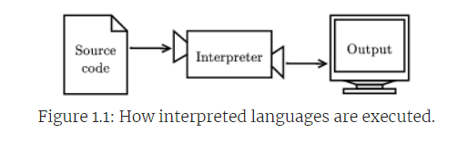
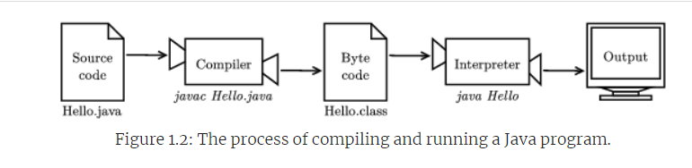
Introduction to java
Compilation and Interpretation in Java

Slide 36
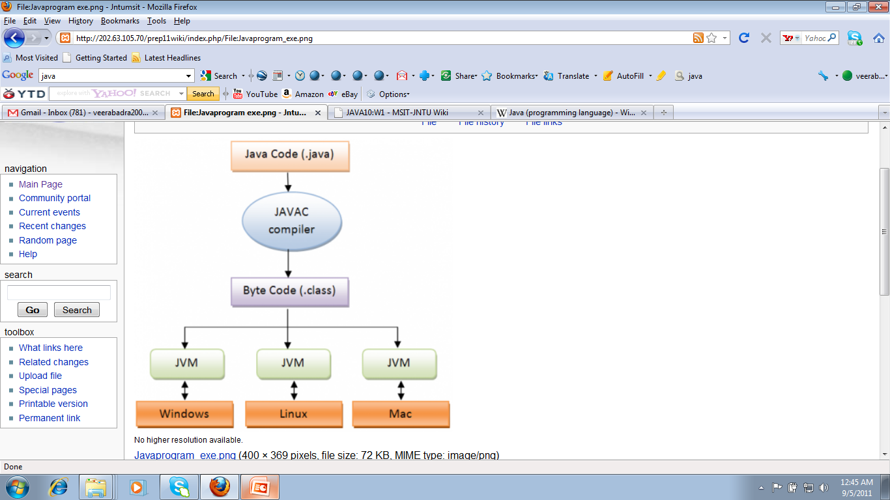
Introduction to java
Compilation and Interpretation in Java (In 1 diagram)

Slide 37
Introduction to java
Compilation and Interpretation in Java

Slide 38
Introduction to java
Compilation and Interpretation in Java
Portability of Byte Code:
Byte code is highly portable, which allows a Java program to be:
Compiled on one machine.
Transferred to another machine.
Run on the other machine without the need for recompilation.
Java Virtual Machine (JVM):
The interpreter that runs the byte code is known as the Java Virtual Machine (JVM), which is central to Java's platform-independent functionality.

Slide 39
Introduction to java
The hello world program:
A simple program that outputs 'Hello, World!' to demonstrate basic syntax.
public class Hello {
public static void main(String[] args) {
// generate some simple output
System.out.println("Hello, World!");
}
}

Slide 40
Introduction to java
The hello world program:
Java Programs Structure.
Made up of classes and methods.
Methods contain statements that perform operations.
Key Components of a Java Program:
Class: Collection of methods. E.g., Hello class in Hello.java.
Method: Named sequence of statements. E.g., main method: public static void main(String[] args).
Statement: Single line of code, like System.out.println("Hello, World!");.

Slide 41
Introduction to java
The hello world program:
Important Java Syntax:
Case-sensitive: System is correct; system and SYSTEM are incorrect.
Uses semicolons (;) to end statements.
Uses curly braces ({}) to group statements within classes and methods.

Slide 42
Introduction to java
The hello world program:
Output in Java:
System.out.println: Prints text to the screen.
println stands for "print line"; differentiates from printing to a printer.
Special Elements:
Main method: The start point of execution. Format and name are crucial.
Comments: Use two slashes (//) for single-line comments to explain code. Ignored during execution.
File Naming and Structure:
Class name should match the file name.
Conventional to start class names with a capital letter.

Slide 43
Introduction to java
Displaying Strings:
You can put as many statements as you like in main. For example, to display more than one line of output:
public class Hello {
public static void main(String[] args) {
// generate some simple output
System.out.println("Hello, World!"); // first line System.out.println("How are you?"); // another line
}
}

Slide 44
Introduction to java
Displaying Strings:
System.out.println appends a special character, called a newline, that moves to the beginning of the next line. If you don’t want a newline at the end, you can use print instead of println:
public class Goodbye {
public static void main(String[] args) { System.out.print("Goodbye, ");
System.out.println("cruel world");
}
}

Slide 45
Introduction to java
Escape sequences:
It is possible to display multiple lines of output in just one line of code. You just have to tell Java where to put the line breaks
public class Hello {
public static void main(String[] args) { System.out.print("Hello!\nHow are you doing?\n");
}
}
//Output
Hello!
How are you doing?

Slide 46
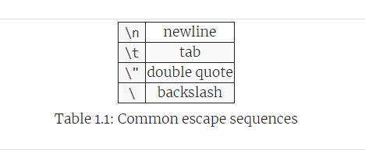
Introduction to java
Escape sequences:
Special characters like \n (newline) and \t (tab).
Example: System.out.println("She said \"Hello!\" to me.");// She said "Hello!" to me.

Slide 47
Introduction to java
Formatting code:
In Java programs, some spaces are required. For example, you need at least one space between words, so this program is not legal:
publicclassGoodbye{
publicstaticvoidmain(String[] args) {
System.out.print("Goodbye, ");
System.out.println("cruel world");
}
}

Slide 48
Introduction to java
Formatting code:
But most other spaces are optional. For example, this program is legal:
public class Goodbye {
public static void main(String[] args) {
System.out.print("Goodbye, ");
System.out.println("cruel world");
}
}

Slide 49
Introduction to java
Formatting code:
The newlines are optional, too. So we could just write:
public class Goodbye {
public static void main(String[] args){
System.out.print("Goodbye, "); System.out.println("cruel world");
}
}
Google publishes its Java coding standards for use in open-source projects: http://google.github.io/styleguide/javaguide.html.

Slide 50
Introduction to java
Debugging code:
Techniques for finding and fixing errors in the code.
Remember that you are not alone, and most if not all programmers have had similar experiences.
Don’t hesitate to reach out to a friend and ask questions!

Slide 51
Introduction to java
Netbeans IDE Installation:
https://youtu.be/45DcRMeLweE

Slide 52
Introduction to java
Netbeans IDE Installation:
Downloading Apache NetBeans 11.1
https://netbeans.apache.org/front/main/download/nb111/nb111/
Download and follow the prompt to install.
Create your first Java project.
Create a class in the project.
Run your project

Slide 53
Exercises

Slide 54
Introduction to java
Exercises:
In computer jargon, what’s the difference between a statement and a comment?
Type in the hello world program, then compile and run it.
Add a print statement that displays a second message after the “Hello, World!”. Say something witty like, “How are you?” Compile and run the program again.
Add a comment to the program (anywhere), recompile, and run it again. The new comment should not affect the result.

Slide 55



